Slide 1
Surmount JEE
“Your Dream , Our Vision”
Developed by:
Ankan Bohara & Prashant Sharma

Slide 2
Project at a glance:
This project is about:
Providing user access to best quality material for JEE.
Mind boggling quizzes.
A real time experience of JEE paper.
Marks after the completion of test.
Overall analysis of the test.
Faster doubt clearance.
Highly experienced content developer.
Latest updates, feeds and notifications.
A highly diligent blocks by experienced authors.

Slide 3
MOTIVATION
The source of motivation in choosing such a project is behind the difficulties faced by us during our preparation time.
There are so many other websites which provide the materials for preparation but failed at the point of their credibility.
All credible blogs from experienced authors at a single place.

Slide 4
FEATURES OF APP
Sessions
Internationalization
Search functionality in blogs
Blogs creation by authenticated users
Marks after quizzes
Performance Analysis after each quiz
Social Media Login
RSS and Atom Feeds
Django Forms
Authentication of users

Slide 5
AUTHENTICATION OF USERS
Here we have used ‘django.contrib.auth’.
From this we have imported authenticate. This enables us to authenticate registered user.
It also helps us in creating fields that are visible only to the selected user.
The login and logout functionality also requires the use of this authentication process.

Slide 6
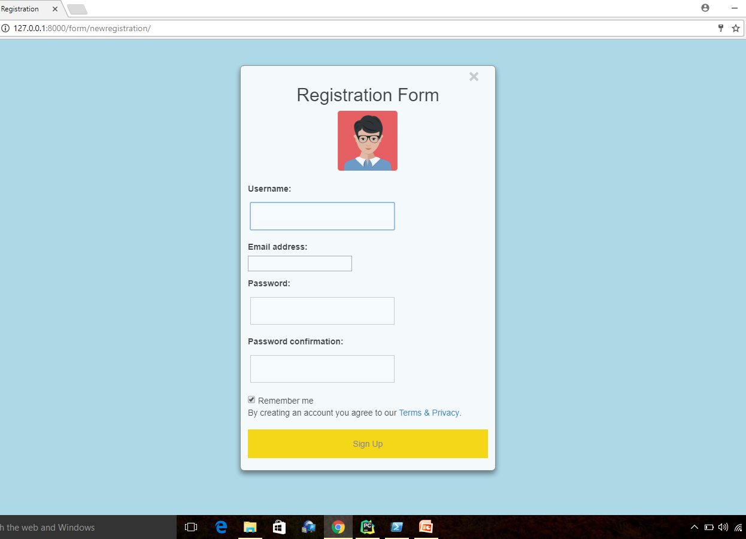
AUTHENTICATION OF USERS
SCREENSHOTS

Slide 7
SESSIONS
We have created sessions using django built in login and logout functionality.
It helps us in client side cookies to save to our databse

Slide 8
INTERNATIONALIZATION
Our web app is available in two other languages beside English. These two are Hindi and Telugu.
Thereby enabling the internationalization feature of the app.

Slide 9
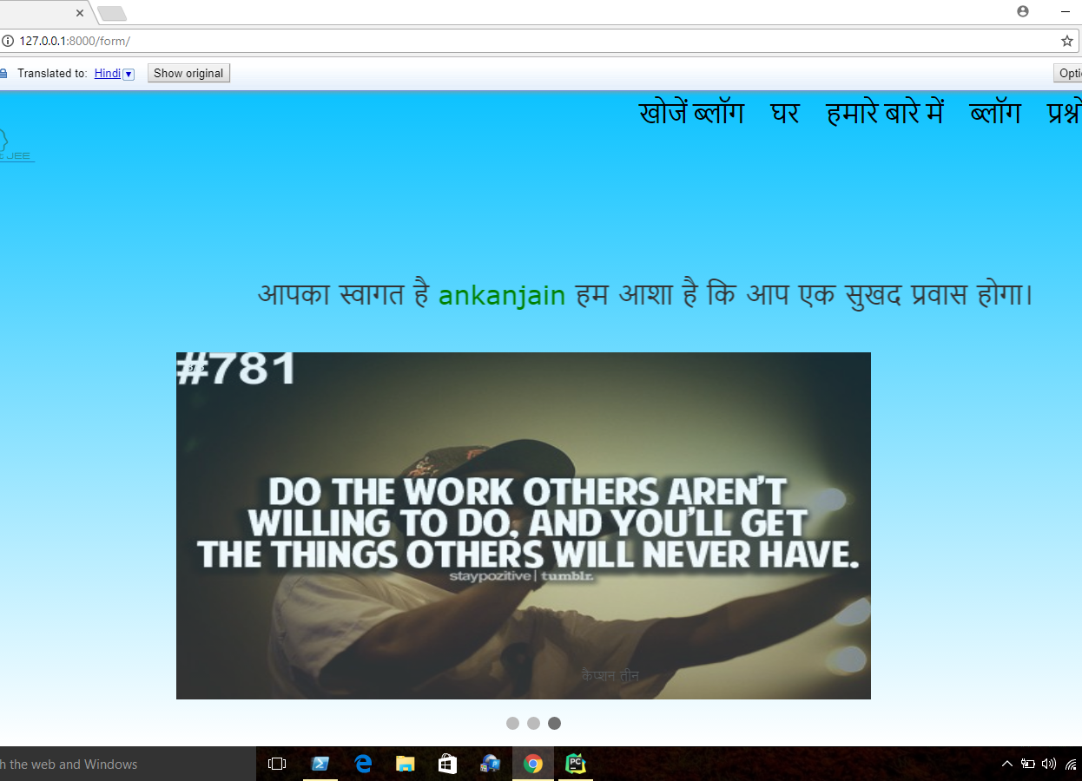
INTERNATIONALIZATION
SCREENSHOT

Slide 10
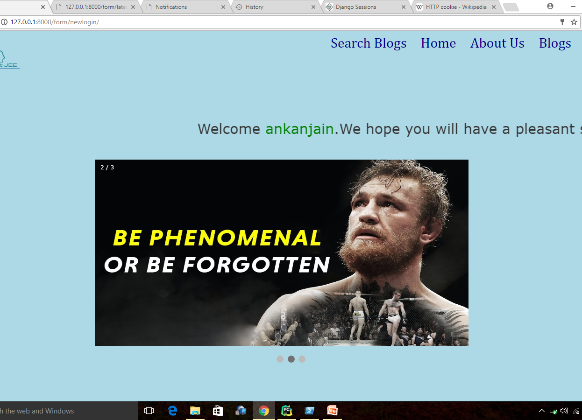
SESSIONS
Screenshot

Slide 11
SOCIAL MEDIA LOGIN
We have used social media login feature to enable our users to login to our website using popular social networking site Facebook and GitHub.
To include this feature we have used built in app ‘social_django’.

Slide 12
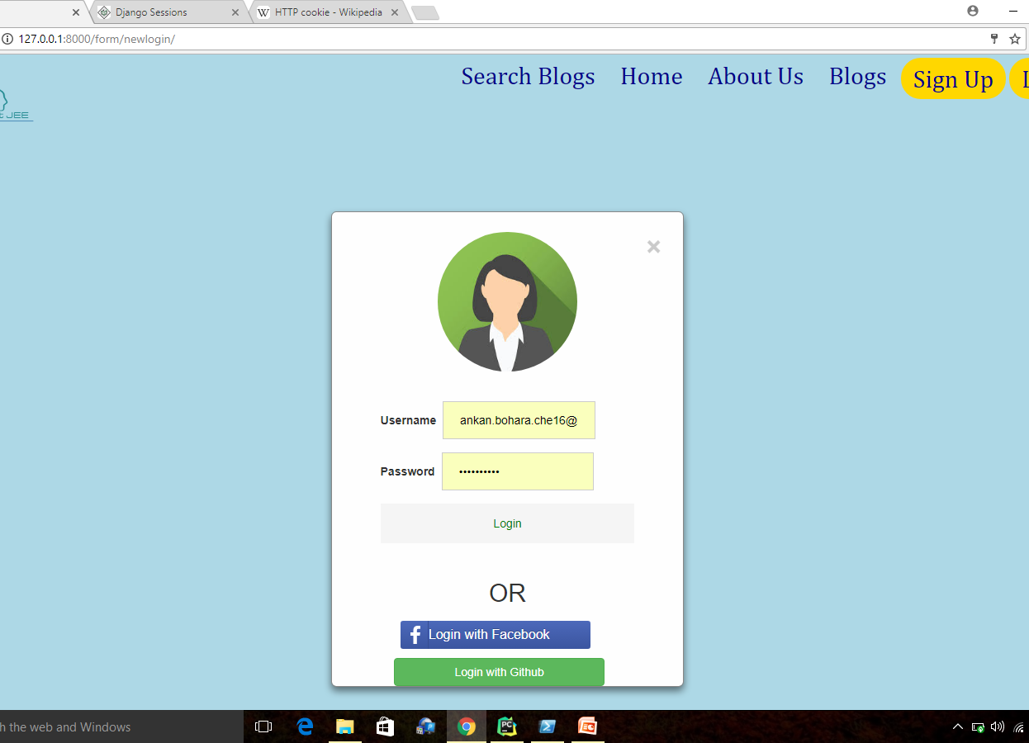
SOCIAL MEDIA LOGIN
SCREENSHOT

Slide 13
RESULT AFTER QUIZZES
We have created a random quiz of 10 questions. The admin can decide the time duration of quiz.
After the completion of quiz, user can see the result as well as the correct answer of the questions.

Slide 14
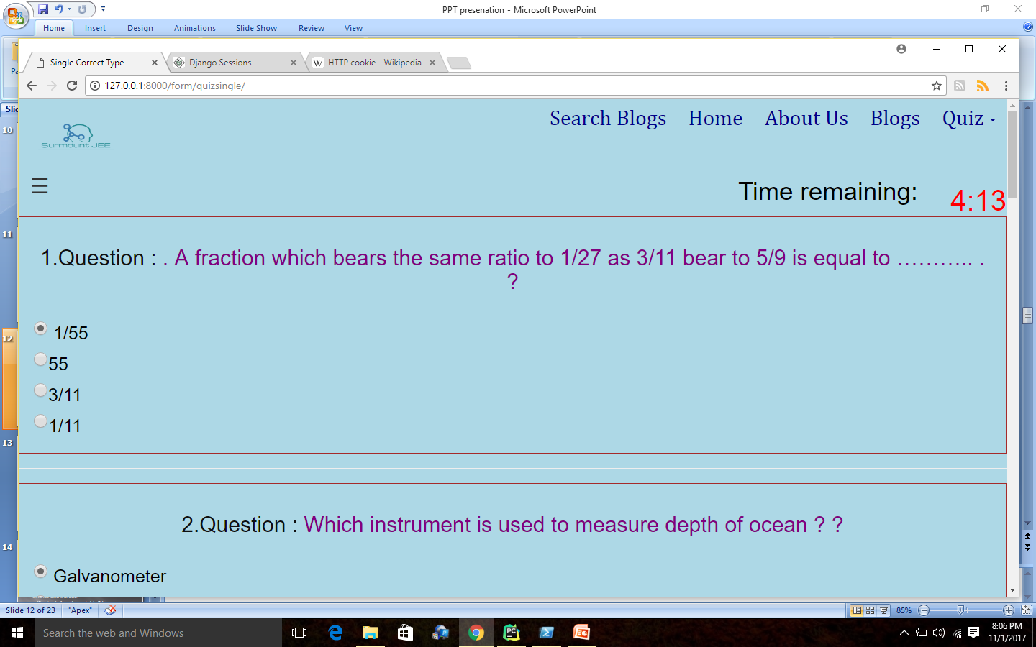
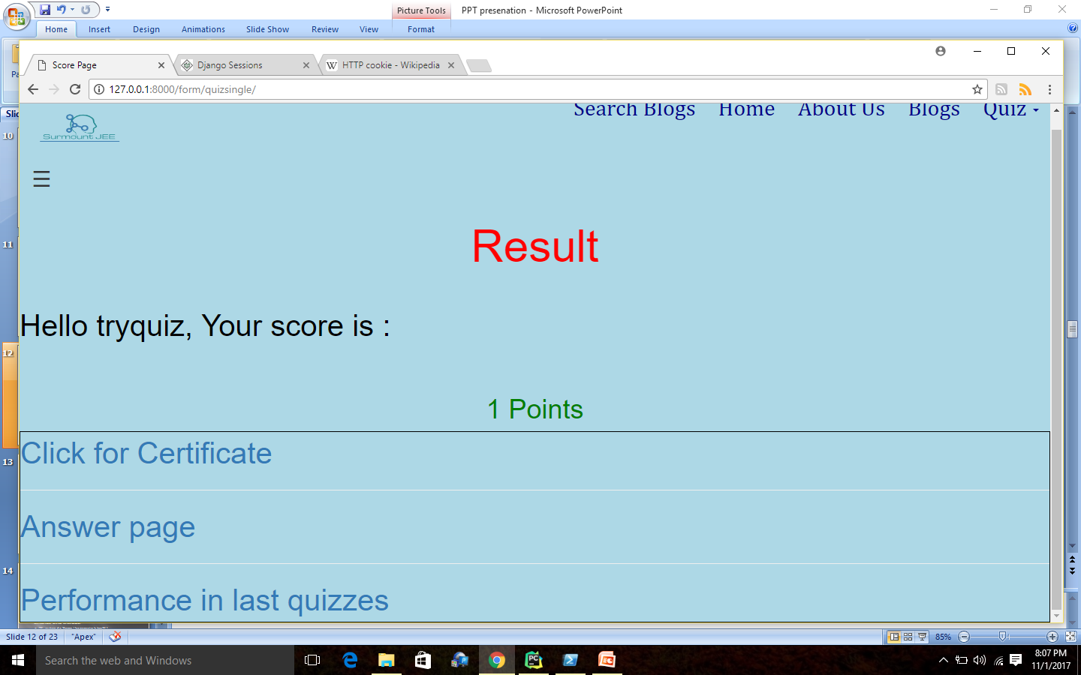
RESULT AFTER QUIZZES
SCREENSHOTS

Slide 15
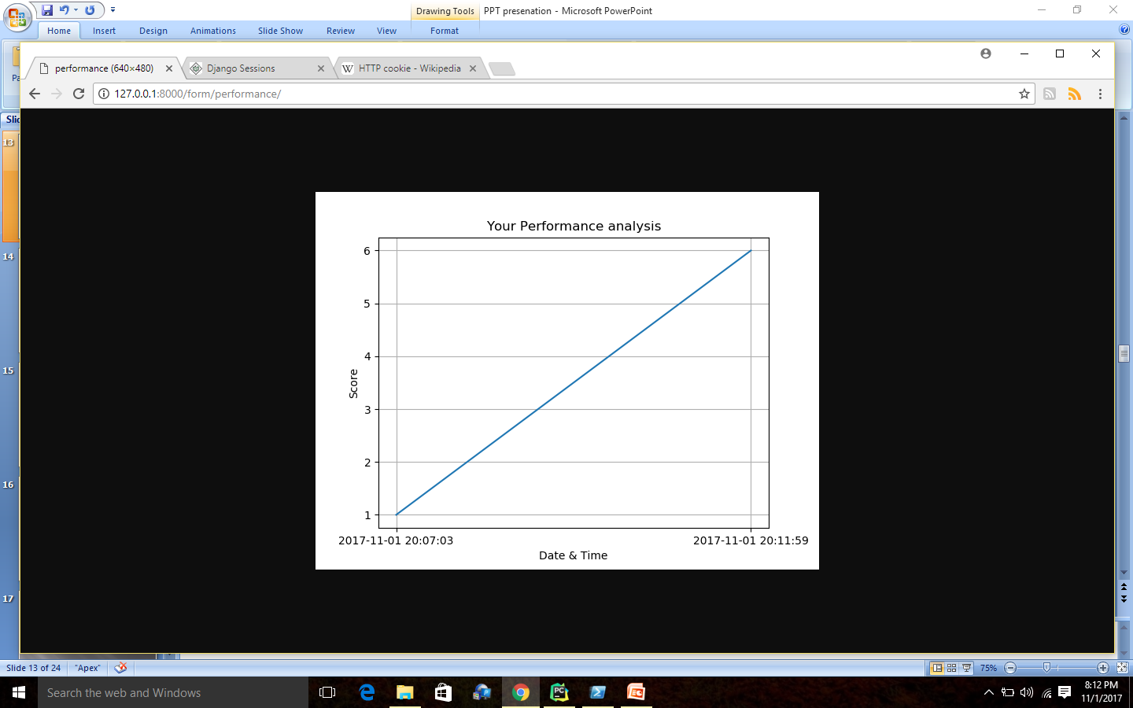
PERFORMANCE ANALYSIS
A student can monitor his performance after the completion of quiz.

Slide 16
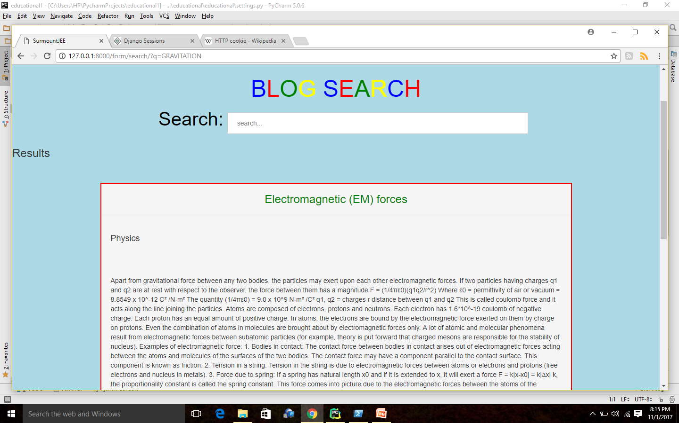
SEARCH FUNCTIONALITY IN BLOGS
A user can search in blogs contributed by other experienced users.
Here we have used the ‘haystack’ app which searches in the blogs and return the results

Slide 17
RSS AND ATOM FEEDS
Logged in user can see the new notifications received using the feature of RSS and Atom Feeds.
We have created the ‘feeds.py’ file in our app. And use the package from ‘django.contrib.syndication.views import Feed’

Slide 18
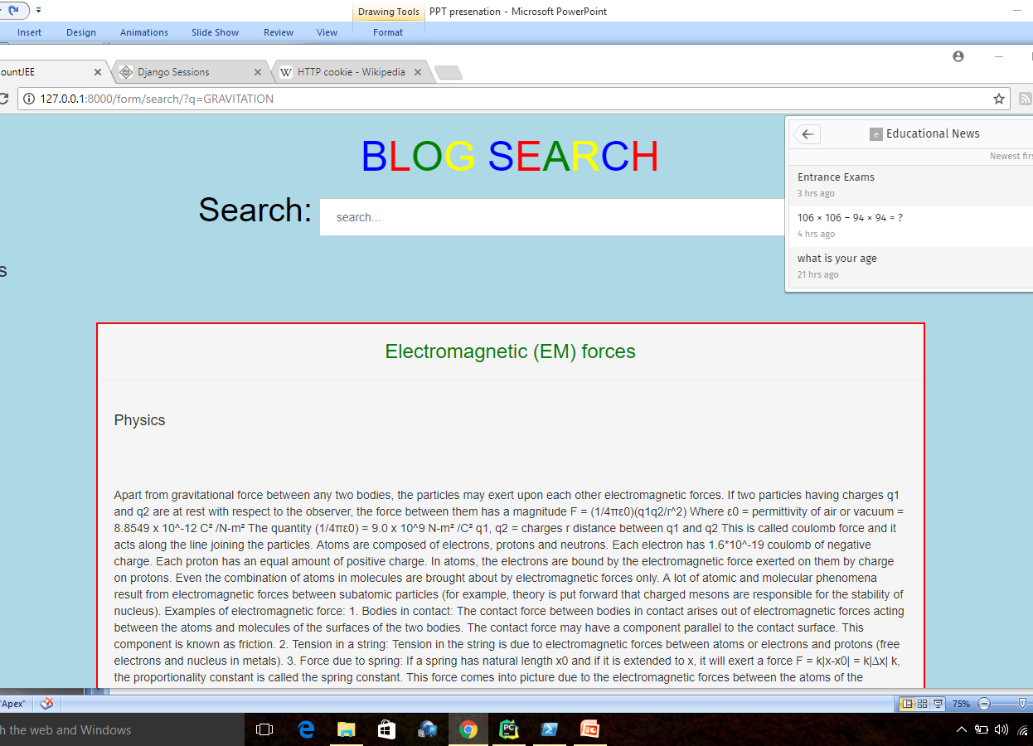
RSS AND ATOM FEEDS
SCREENSHOT

Slide 19
CUSTOM MIDDLEWARE
This feature enables the user to first login then access other functionality of the website

Slide 20
DJANGO FORMS
The robust library of Django made us possible to design basic ‘Login’, ’Registration’, ‘Feedback’ , ‘Enquiry’ ,’Blogs’.
We learnt how to use the hard coded html page to submit data to our database.

Slide 21
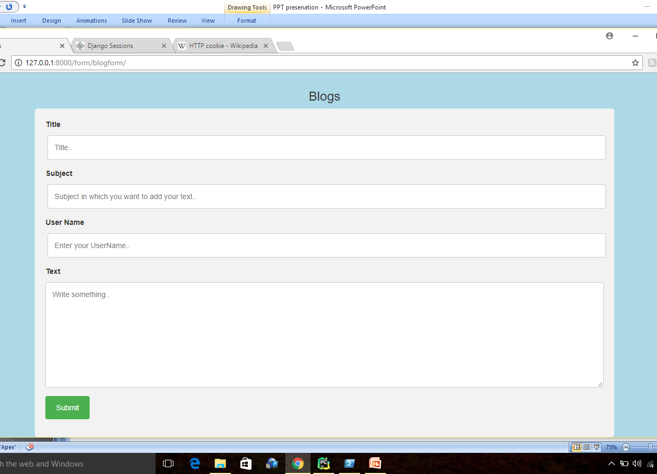
DJANGO FORMS
SCREENSHOT

Slide 22
INDIVIDUAL CONTRIBUTION
ANKAN’S CONTIBUTION
QUIZ PREPARATION
RESULT AFTER THE QUIZ
SOCIAL MEDIA LOGIN FEATURE-FACEBOOK
RSS AND ATOM FEEDS
USER REGISTRATION
BLOG,CONTACT FORM
MOSTLY BACKEND PART
PERFORMANCE ANALYSIS AFTER THE QUIZ
PRASHANT’S CONTRIBUTION
FRONT END PART
SEARCH IN BLOGS
SOCIAL LOGIN FEATURE USING GITHUB
LOGIN,FEEDBACK FORM
AUTOMATIC SUBMISSION OF FORM ON COMPLETION OF QUIZ
INTERNATIONALIZATION PART
CUSTOM MIDDLEWARE

Slide 23
REFERENCES
https://docs.djangoproject.com/en/1.11/
https://tutorial.djangogirls.org/en/
https://simpleisbetterthancomplex.com/

Slide 24
THANK YOU

